Slide 1
RC2
VC 210 Recitation Class
Linda Wei
SJTU

Slide 2
3.Atom

Slide 3
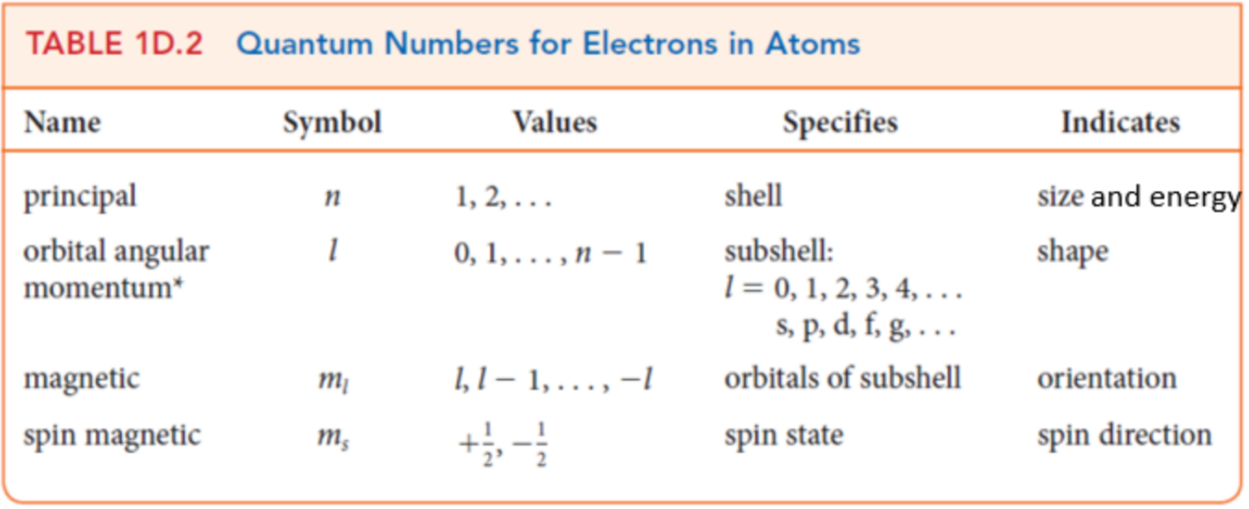
Quantum Number

Slide 4
Number of Nodes
Total:n-1
angular:l
radial:n-l-1

Slide 5
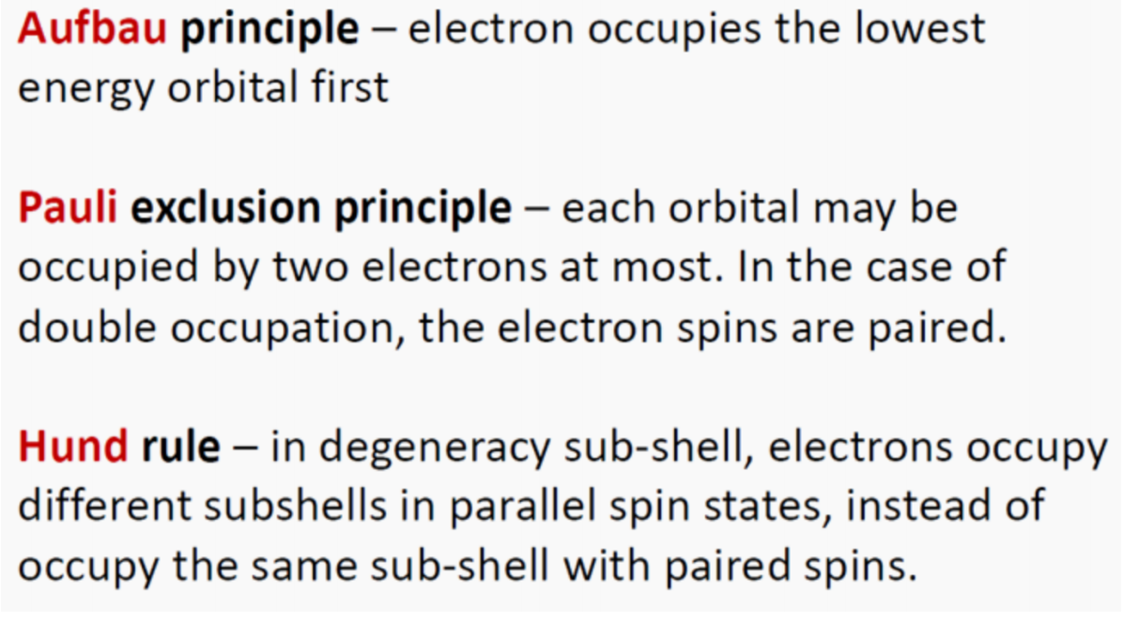
Electron Configuration

Slide 6
Atom radius
1、Atom radius:Number of valence shells: number of shells↑, radius ↑
2、Effective nuclear charge: effective nuclear charge ↑, radius ↓.
Effective nuclear charge:
Atom (non-charged): proton number ↑, effective nuclear charge ↑
Ions (charged): charge number ↑, effective nuclear charge ↑.

Slide 7
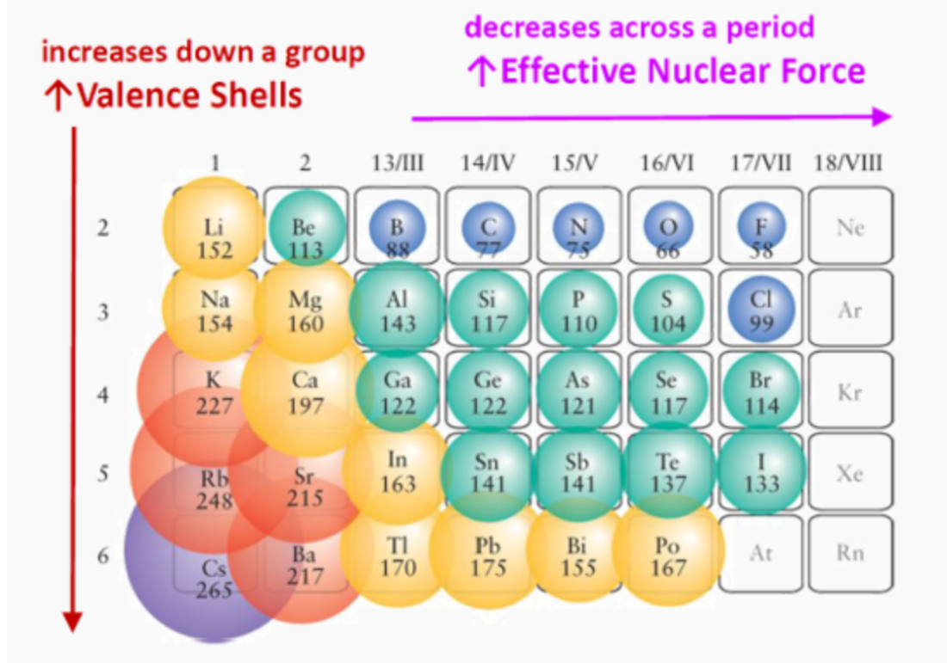
Periodic

Slide 8
Ionization Energy(I₁）
Definition: the minimum energy needed to remove 1 electron from a gas atm. eg. K(g)
Trend of the first ionization energy:
Valence shells ↑, I₁ ↓.
Effective nuclear charge ↑, I₁ ↑

Slide 9
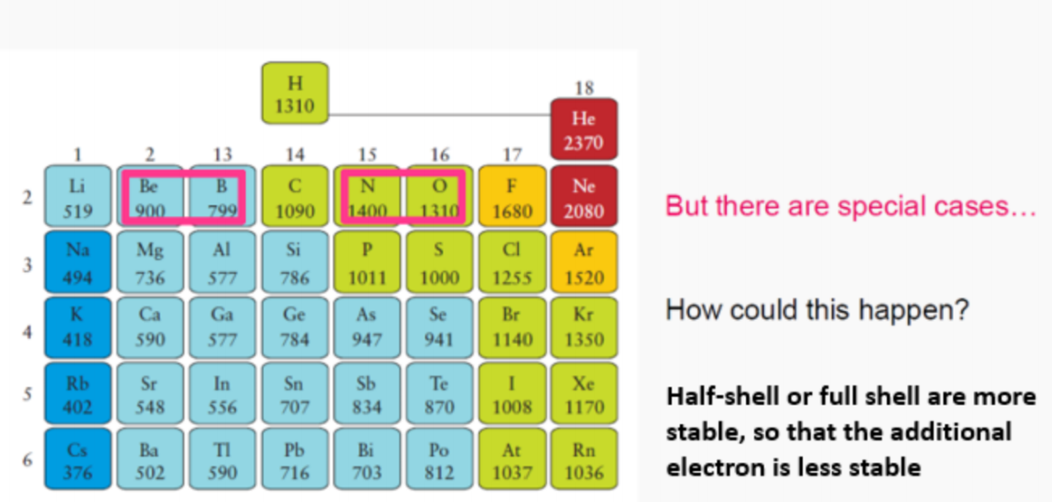
Attention！

Slide 10
Electron Affinity
Definition: the energy released when 1 electron is added to a neutral
atom in gaseous state to form a negative ion.
Positive: energy released
Negative: energy absorbed
Contrast to ionization energy.
ctpp!

Slide 11
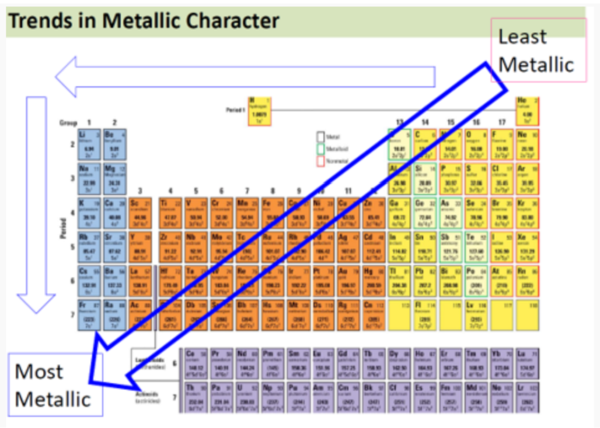
Metallic Character

Slide 12
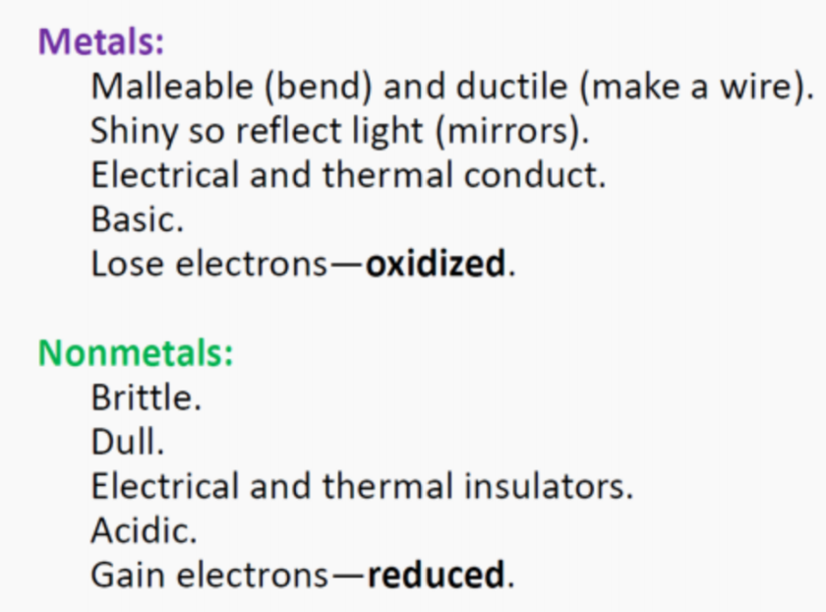
Characteristic of Metal and nonmetal

Slide 13
Reference
[1] CHEMICAL PRINCIPLES-THE QUEST FOR INSIGHT
(Seventh Edition)
[2] Wei Xiwen, RC2, VC210 FA2020
[3] Shi Weili, RC2, VC210 FA2020
[4] Huang qin, RC2,VC210 FA2020

Slide 14
Thank you~

